Slide 1
Developing a framework for assessing use and reuse
Ayla Stein, Genya O’Gara, Santi Thompson, Elizabeth Kelly, Caroline Muglia, and Liz Woolcott

Slide 2
Project Team
Santi Thompson (PI), University of Houston
Elizabeth Joan Kelly, Loyola University New Orleans
Genya O’Gara, Virtual Library of Virginia (VIVA)
Caroline Muglia, University of Southern California
Ayla Stein, University of Illinois at Urbana-Champaign (UIUC)
Liz Woolcott, Utah State University

Slide 3
Background
Surveying the Landscape: Use and Usability Assessment of Digital Libraries (2015) white paper
2017 National Leadership Grant (LG-73-17-0002-17)
July 01, 2017 – June 30, 2018
Notes:
Surveying the Landscape: Use and Usability Assessment of Digital Libraries (2015) white paper by DLF Assessment Interest Group User Studies Working group
Applied for and received, much to our surprise, a 2017 National Leadership Grant (LG-73-17-0002-17) from the IMLS

Slide 4
Goals
Identify sustainable and vetted assessment techniques that can be applied to a broad array of digital library collections.
1
Support cultural heritage organizations in deepening their understanding of the ways users engage with, reuse, and transform digital content.
2
With the digital library community, develop approaches and best practices for communicating the economic, educational, scholarly, scientific, social, and cultural impact of digital collections.
3

Slide 5
Advisory Board
Hannah Frost, Stanford Libraries
Emily Gore, Digital Public Library of America
Krystyna K. Matusiak, University of Denver
Sandra Phoenix, HBCU Library Alliance
Dorothea Salo, University of Wisconsin at Madison
Ali Shiri, University of Alberta

Slide 6
Data Collection
Initial survey
In-person focus groups (2 sessions, 3 rounds)
Virtual focus groups (2 sessions, 2 rounds)
Final survey

Slide 7
Deliverables
Grant report
Project data
White paper
Journal article
Webpage – https://reuse.diglib.org/

Slide 8
Use vs. Reuse: What’s the difference?
What *is* the difference between use and reuse metrics?
*Is* there even a difference?
Good question! - We’re not entirely sure either
Definitions for discussion
Notes:
Before I get too much farther, I’m briefly going to touch on definitions.
You may be asking, what is the difference between use and reuse metrics? *Is* there a difference?
We believe there is which is why we’re doing this project
But the difference isn’t necessarily clear - and there are certainly not community-wide accepted definitions.
So we came up with our own for the purposes of this project.
To be clear, we are not married to these definitions. We developed them as starting points for discussion.
Part of what we hope to do during the course of this project is to refine these definitions with the input we’ve received from our focus groups.

Slide 9
Use vs. Reuse: What’s the Difference? - 2
Use: Discovering and browsing objects in a digital library, often described as “clicks” or “downloads,” without knowing the specific context for this use.
Assessment examples: basic web analytics such as number of downloads (unmediated), web traffic information, IP address location, referrals from specific sites, etc.
Notes:
We defined use as: “Discovering and browsing objects in a digital library, often described as “clicks” or “downloads,” without knowing the specific context for this use.”
Examples of this would be: basic web analytics such as clicks and (unmediated) downloads of course. Unmediated here meaning the resource can be downloaded by a user without requesting/needing to request permission.
Also: web traffic information, IP address location, referrals from specific sites, etc.
This is in no way an exhaustive list.

Slide 10
Use vs. Reuse: What’s the difference? - 3
Reuse: how often and in what ways digital library materials are utilized and repurposed. In this definition, we do know the context of the use.
Assessment examples: log requests for images, reverse image lookup information, citation metrics of data and/or digital collection materials, inclusion of digital collection materials in an external dataset (e.g. HTRC datasets or curated Internet Archive user collections), remixing songs, mashups of two or more songs, creating memes, sharing on social media
Notes:
Now we defined reuse as: “how often and in what ways digital library materials are utilized and repurposed. In this definition, we do know the context of the use.”
And examples of this would be: logged requests for images, reverse image lookup information, citation metrics of data and/or digital collection materials, inclusion of digital collection materials in an external dataset (e.g. HTRC datasets or curated Internet Archive user collections), remixing songs, mashups of two or more songs, creating memes, sharing on social media.
Again, this is by no means an exhaustive list or even finalized definition. But it’s the stepping off point.
Alright, since we have use vs. reuse all sorted, lets move on.

Slide 11
OK, how does metadata fit into this?
We’re considering all types of (digital) data
Metadata = Data
Digital collection metadata, linked data vocabularies, catalog records, etc.
How is metadata reused?
DH projects: maps, timelines, text analysis
Repurposing catalog records for digital materials
Others
Notes:
This is great and all but how does this relate to metadata at all???
First of all, metadata is data even if we don’t usually think of it that way.
Digital collection metadata, linked data vocabularies, MARC catalog records, etc.
Second, in addition to the main “content”, metadata also sometimes has information that can be used in original/transformative ways.
How is metadata reused?
Used in DH projects: maps, timelines, text analysis
Converting MARC records describing print materials into Dublin Core XML describing a digitized version
Among others that I haven’t thought of
I want to reiterate that none of these definitions or example instances of reuse are set in stone. If you disagree with anything, please tell us! (Preferably in an email so we don’t forget)

Slide 12
The Road So Far
Initial survey – Complete
In-person focus groups (2 sessions, 1 round) – 2nd round @ C4L 2018
Virtual focus groups (2 sessions, 1 round) – 2nd round in March
Final survey – Informed by focus group data
Notes:
We’re fully in the midst of the data collection process
So far, we’ve completed initial analysis of the first survey and have collected data from one round of in-person focus groups.
The second round of in-person focus groups is scheduled to take place at the tail end of Code4Lib2018 later this week

Slide 13
The (first) Survey
How do cultural heritage organizations (and research institutions) currently assess digital library reuse?
If not, why not? (barriers?)
If yes, why? And what metrics do you collect?
What resources would help you implement reuse assessment?
Tools, how-to guides, training opportunities (money & personnel)
Preliminary results helped shape focus group questions
Notes:
Unfortunately we’re still analyzing the data from the first round of in-person and virtual focus groups, so I won’t be presenting takeaways from that
BUT I do have some high-level takeaways for you from the first survey
The purpose of the first survey was to give the project team a baseline understanding of current assessment practices among a diversity of digital library institutions and communities, with a focus on what barriers to reuse assessment exist.
We asked Qs on:
If organizations assessed reuse at all;
If they don’t assess/track reuse, what is preventing them from doing so?
If they are assessing reuse, what metrics are they collecting and how?
And then finally, what kinds of resources would help practitioners to implement reuse assessment?
Tool suggestions, how-to guides, training opportunities, money and personnel (can’t do anything for that, sorry)
We used very preliminary survey results to help come up with discussion questions for our focus groups

Slide 14
Some Survey Numbers
The survey had 19 questions, 409 respondents, and of that initial data set, 302 surveys were deemed to be part of the usable data set.
Not every respondent answered every question – skip logic
Respondents were mostly from academic libraries
30% indicated they were from organizations that served under-represented populations.
Notes:
The survey had 19 questions, 409 respondents, and of that initial data set, 302 surveys were deemed to be part of the usable data set.
Respondents were primarily from libraries in academic institutions, however thirty percent of respondents were from institutions that served under-represented groups.
Including respondents who self-identified their organization as being part of an:
HBCU, Hispanic-serving institution
Tribal institution (Library, Archives, Museum)
And a part of the National Library Service for the Blind and Physically Disabled Network

Slide 15
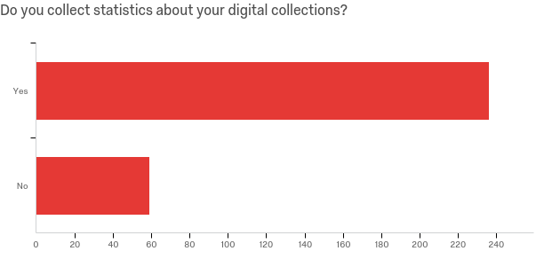
Survey Numbers - Use
Yes – 80%
No -20%
New digital library program
Lack of staff
Notes:
Most (about 80%) of respondents collect use statistics, and those who didn’t (about 20%) cited either
beginning a new digital collection or lack of staffing as the primary reasons for not collecting statistics.

Slide 16
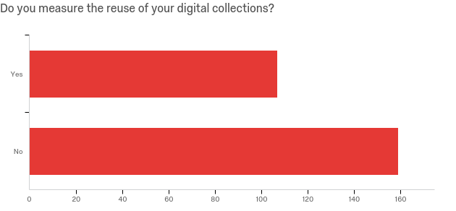
Survey Numbers - Reuse
Yes – 40%
Mostly social media
No – 60%
No clearly accepted methodology or system
Lack of time
Not enough staff
Notes:
However only about 40% are collecting any type of reuse statistics with the most common method for collecting this data being through “social media metrics”.
Reasons for not collecting reuse data were striking, with the most cited reason for not collecting being a lack of an accepted methodology or system for collecting data, followed by lack of time and staff.

Slide 17
Recommendation Highlights
Assessment metrics must demonstrate impact
Provide how-to training:
Gather reuse/use & standardize use metrics
Advocate for resources through metrics
Convert metrics into impact statements
Patron privacy & new technology
Notes:
Ensuring assessment metrics demonstrate impact
Providing training on how to
Gather reuse statistics
Gather use statistics (or standardize appropriate use statistics)
Advocate through metrics for greater staffing and funding to address needs
Convert metrics into impact statements/make metrics personally impactful
Developing a conversation around patron privacy
Technological developments (where possible) that streamline the data collection process for both use and reuse

Slide 18
Key Finding: Standards
Munroe, Randall. “Standards”. Web comic. https://xkcd.com/927/.
CC BY-NC 2.5
Notes:
And the key recommendation from survey responses was: developing standards and best practices
Nearly all of our respondents wanted some sort of standard that indicates what metrics to use and how to collect that data.
Also considerable interest in developing a shared database of metrics, to help look at trends on the larger scale and show impact of CHOs in the aggregate

Slide 19
Takeaways & Next Steps
Survey results can be used as benchmark for community progress
NO FREE TEXT
Collect and analyze focus group data
Notes:
This initial survey will be of huge benefit after a toolkit that includes best practices has been created, because we can then measure how far we’ve come as a community to address the issues cited here.
Our primary “lesson learned” from this initial survey construction was NO FREE TEXT unless there is absolutely no other way to answer a question.
Unfortunately, we ended up having to toss out several questions that relied on free-text answers – respondents didn’t interpret the questions in the way we intended
Next Steps
Continue to collect and analyze our focus group data

Slide 20
Thanks!
Project website: https://reuse.diglib.org/
Twitter: @thestackscat

